Slide 1
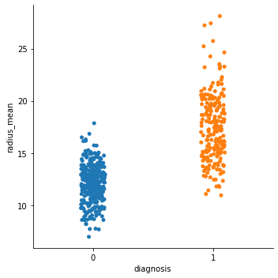
Classification – breast cancer data

Slide 2
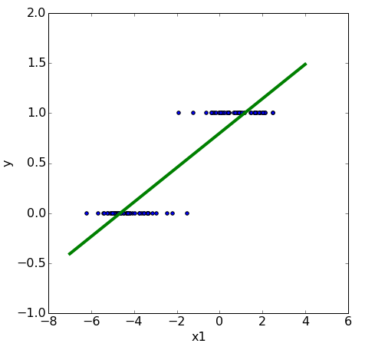
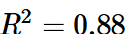
classification
We need to make
assumptions
about the
model
that generated the data.
linear relationship
linear model

Slide 3
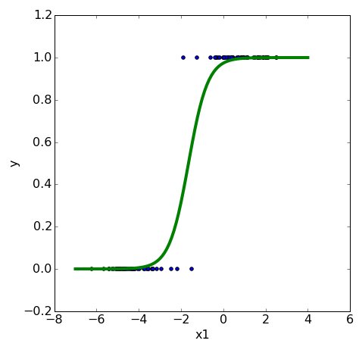
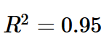
logistic regression
We need to make
assumptions
about the
model
that generated the data.
linearly separable
logistic model

Slide 4
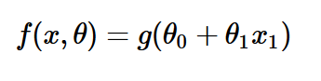
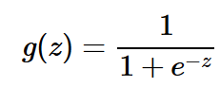
logistic regression

Slide 5
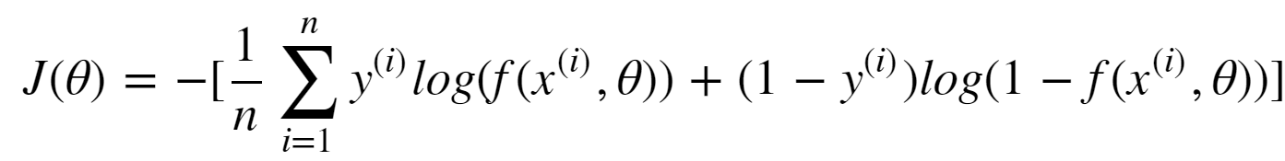
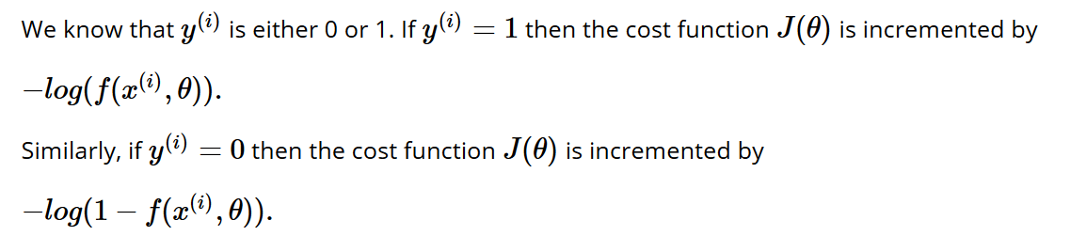
logistic regression: cost (loss function)

Slide 6
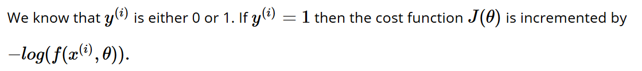
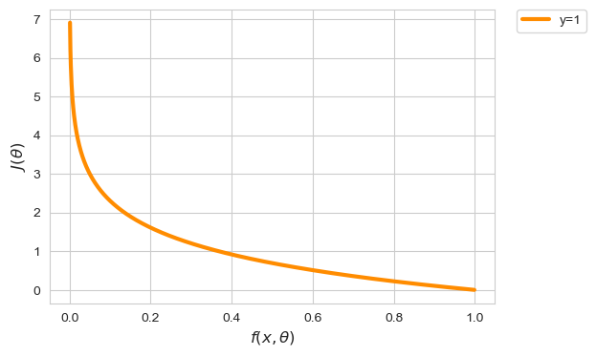
logistic regression: cost (loss function)
Notes:
X-as is predictie
Y-as is cost van predictie indien y == 1

Slide 7
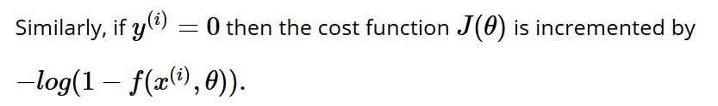
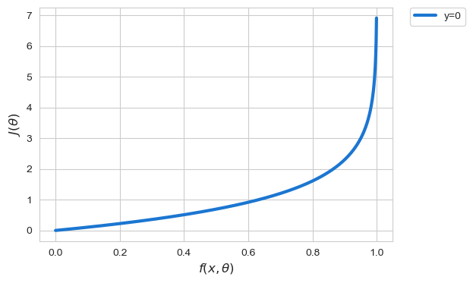
logistic regression: cost (loss function)

Slide 8
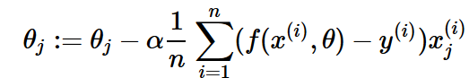
logistic regression
Fit a logistic model
to the data set such that the cost function
is minimal using gradient descent
Notes:
Also convex!

Slide 9
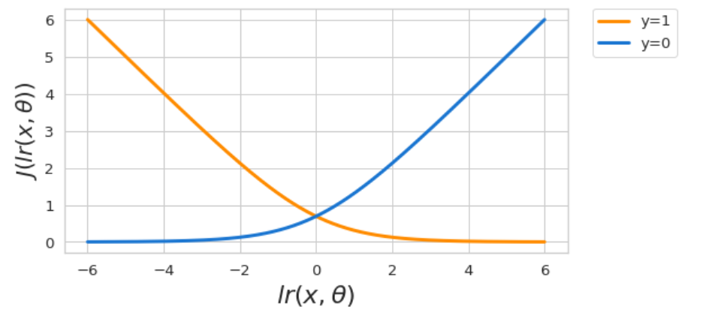
Logistic regression: cost (loss function)

Slide 10
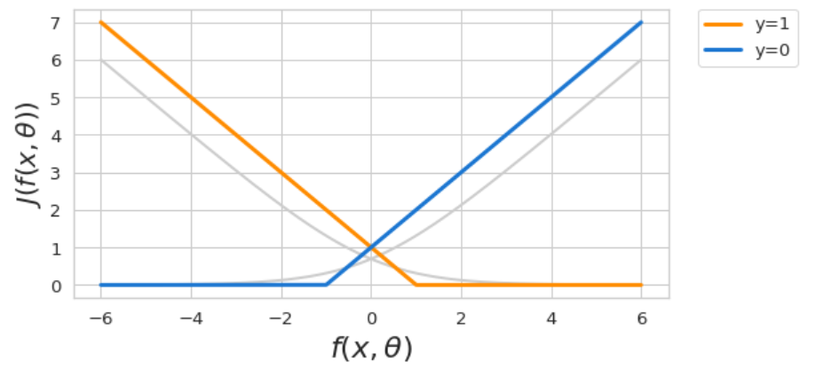
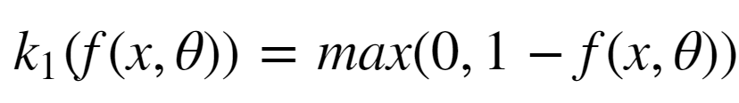

Support vector machine: cost (loss function)
replace cost function by piecewise linear function
if y = 1 then the contribution to the cost is
Machine Learning Methods for Biomedical Data (D012554)

Slide 11
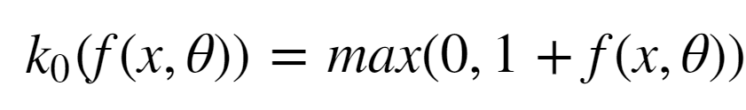
Support vector machine: cost (loss function)
replace cost function by piecewise linear function
if y = 0 then the contribution to the cost is
Machine Learning Methods for Biomedical Data (D012554)

Slide 12
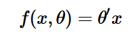
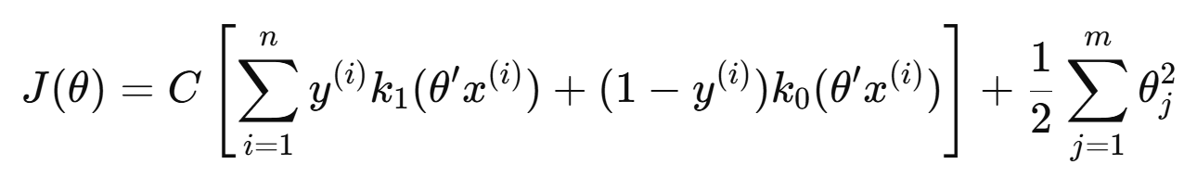
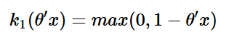
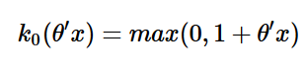
Support vector machine: cost (loss function)
Fit a linear model
such that
with and
is minimized.
Machine Learning Methods for Biomedical Data (D012554)

Slide 13
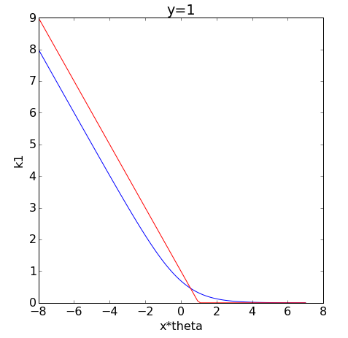
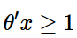
Support vector machine: cost (loss function)
In this case the contribution to the cost needs to be small when the model predicts high values (>0) and large when the model predicts low values (<0).
For SVMs we see that the contribution to cost decreases linearly and becomes zero when
Machine Learning Methods for Biomedical Data (D012554)

Slide 14
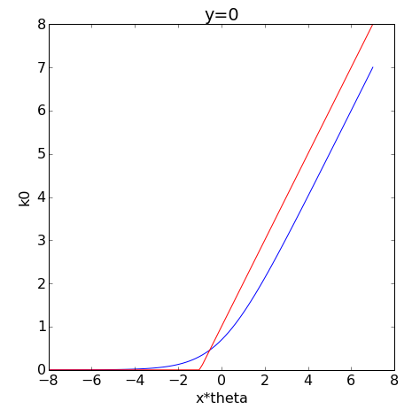
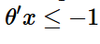
Support vector machine: cost (loss function)
In this case the contribution to the cost needs to be large when the model predicts high values (>0) and small when the model predicts low values (<0).
For SVMs we see that the contribution to the cost is zero for
and then increases linearly.
Machine Learning Methods for Biomedical Data (D012554)

Slide 15
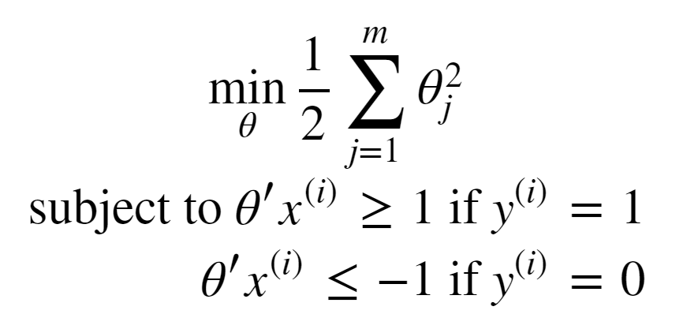
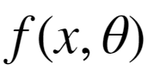
Support vector machine: cost (loss function)
Consider a train set with two classes that are perfectly linearly separable.
The piecewise cost function can be made zero.
The SVM objective can be written as
Machine Learning Methods for Biomedical Data (D012554)
Notes:
Error:C needs to be put outside!!

Slide 16
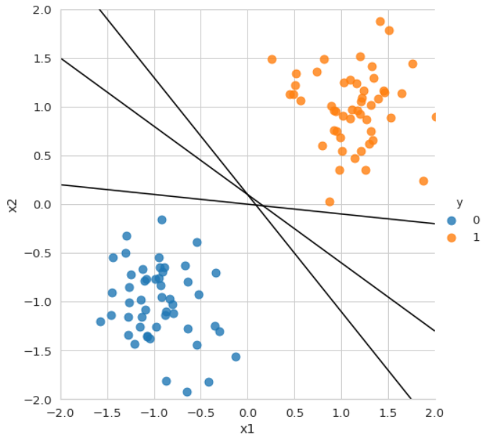
Machine Learning Methods for Biomedical Data (D012554)

Slide 17
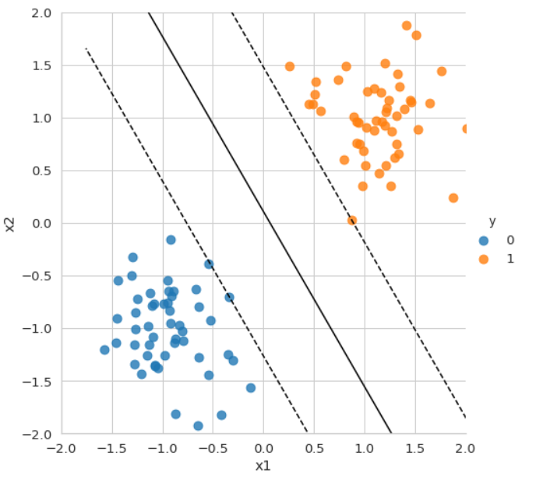
Machine Learning Methods for Biomedical Data (D012554)

Slide 18
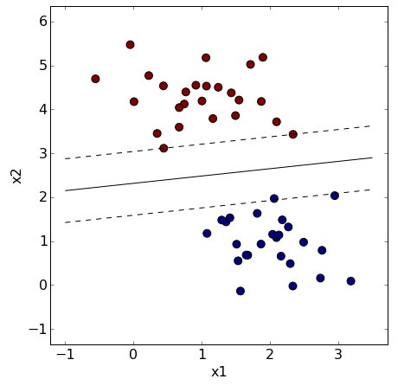
Support vector machine: large margin classifier
Machine Learning Methods for Biomedical Data (D012554)

Slide 19
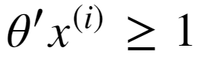
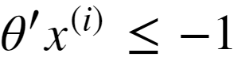
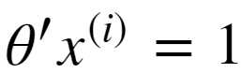
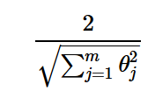
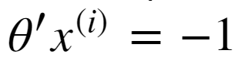
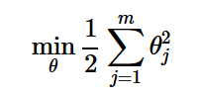
Support vector machine: large margin classifier
red points statisfy
blue points satisfy
distance bewteen two dashed lines is
SVM objective was
Machine Learning Methods for Biomedical Data (D012554)

Slide 20
Support vector machine
Soft margin SVM allows some misclassification by introducing slack variables (𝜉) to handle overlapping classes, making the model more flexible when data is not perfectly separable.
It balances margin maximization and classification error using a regularization parameter (𝐶), where a small 𝐶 allows more misclassifications (wider margin), and a large 𝐶 forces stricter separation (narrower margin).
Soft margin SVM improves generalization by preventing overfitting in noisy or complex datasets while still maintaining a robust decision boundary.
Machine Learning Methods for Biomedical Data (D012554)

Slide 21
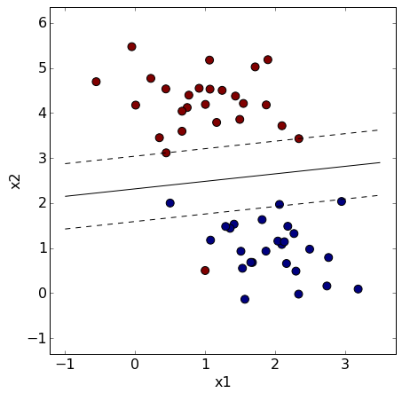
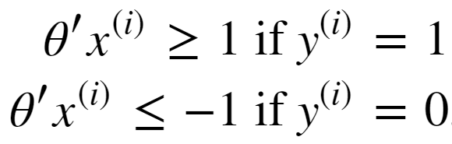
Support vector machine: soft margin
Machine Learning Methods for Biomedical Data (D012554)

Slide 22
Support vector machine: soft margin
Machine Learning Methods for Biomedical Data (D012554)

Slide 23
Support vector machine: soft margin
Machine Learning Methods for Biomedical Data (D012554)

Slide 24
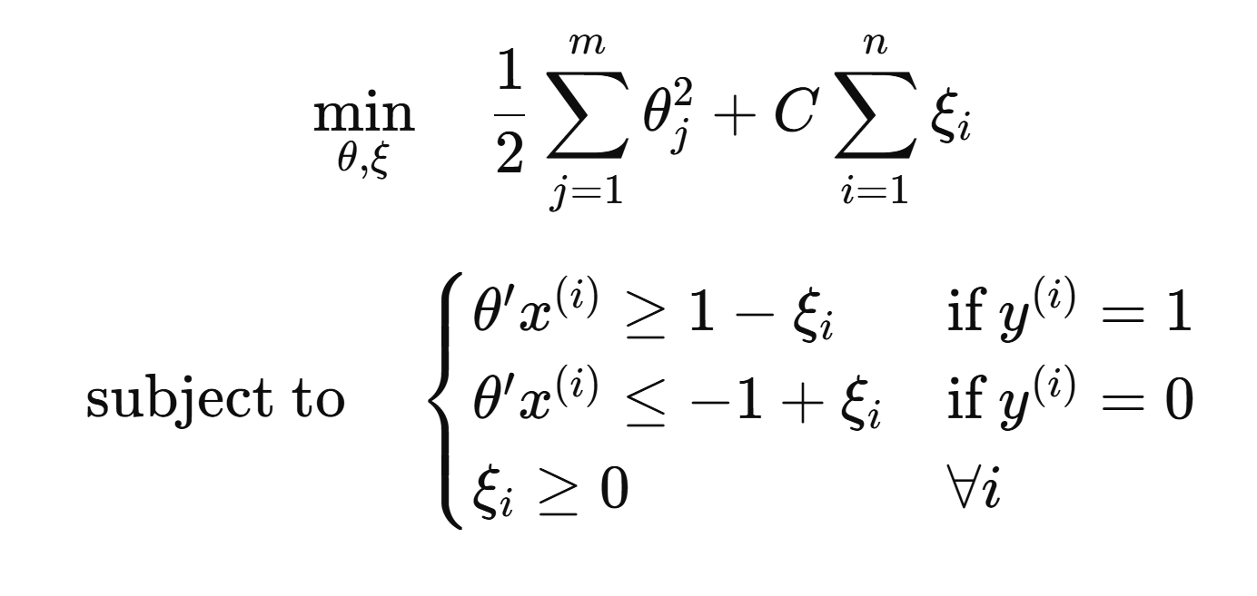
Support vector machine: soft margin
Machine Learning Methods for Biomedical Data (D012554)

Slide 25
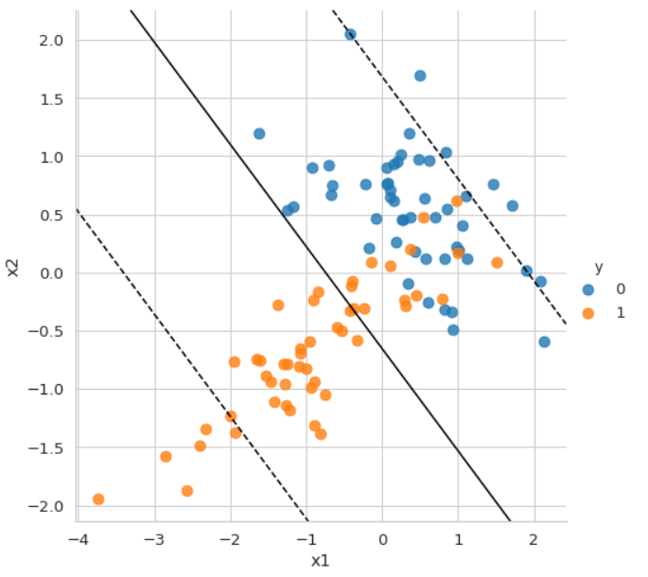
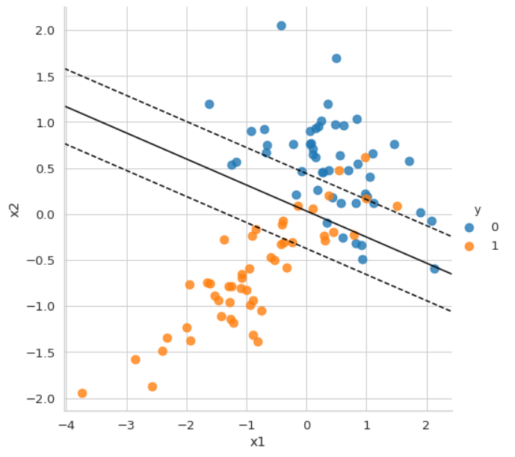
Support vector machine: regularization hyperparameter
Machine Learning Methods for Biomedical Data (D012554)

Slide 26
Support vector machine: kernels
The kernel trick allows SVM to handle non-linearly separable data by transforming input features into a higher-dimensional space where a linear decision boundary can be found.
Common kernel functions include Polynomial, Radial Basis Function (RBF), and Sigmoid, each mapping data to a different feature space to capture complex relationships.
It avoids explicitly computing high-dimensional transformations, making computations efficient while still benefiting from the power of non-linear feature mappings.
Machine Learning Methods for Biomedical Data (D012554)

Slide 27
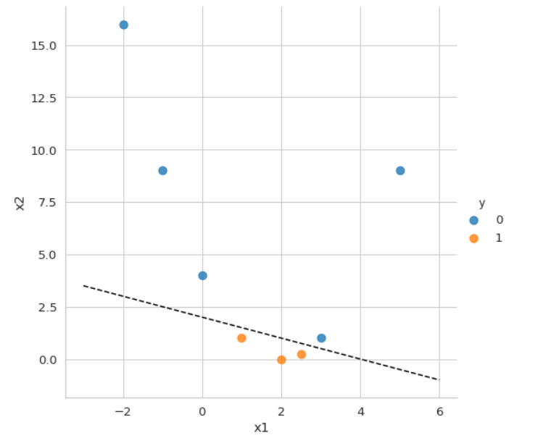
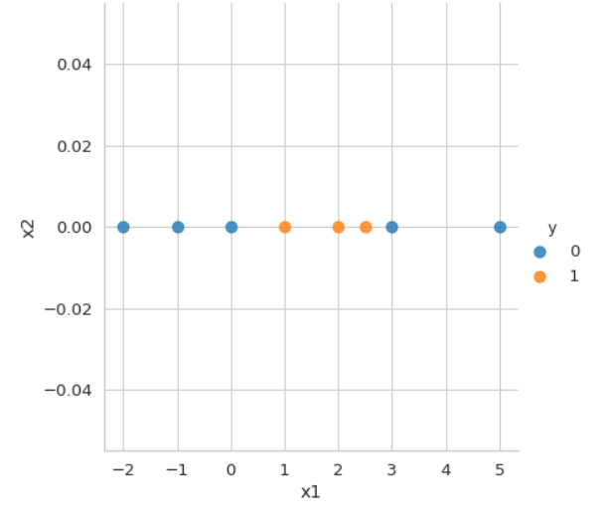
Support vector machine: kernels
Machine Learning Methods for Biomedical Data (D012554)

Slide 28
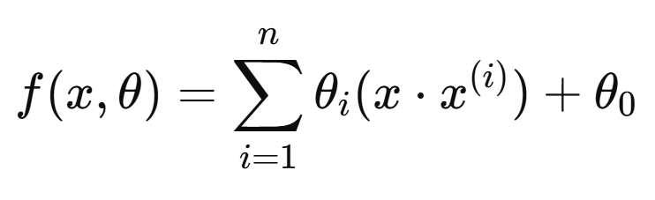
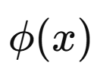
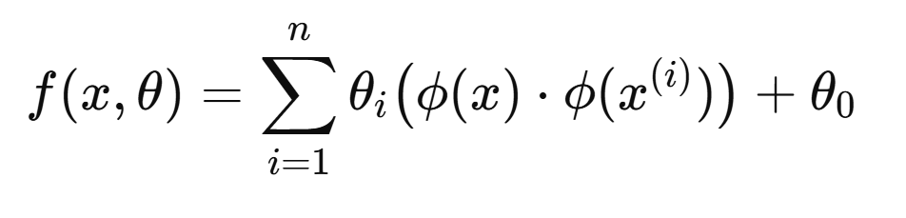
Support vector machine: kernels
SVMs can also be formulated as a linear function of the samples (dual form) instead of the features as
where a model parameter is associated with a datapoint instead of a feature.
If we apply a polynomial transformation we obtain
Machine Learning Methods for Biomedical Data (D012554)

Slide 29
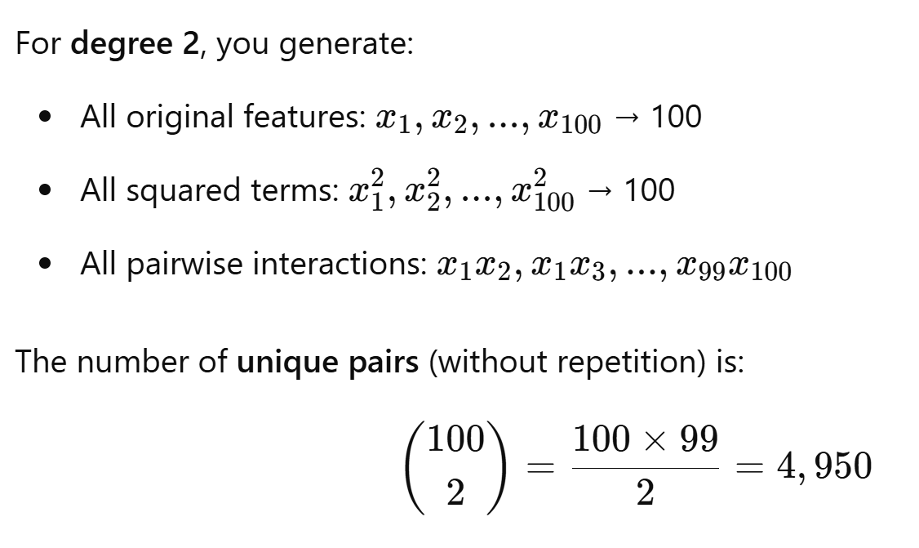
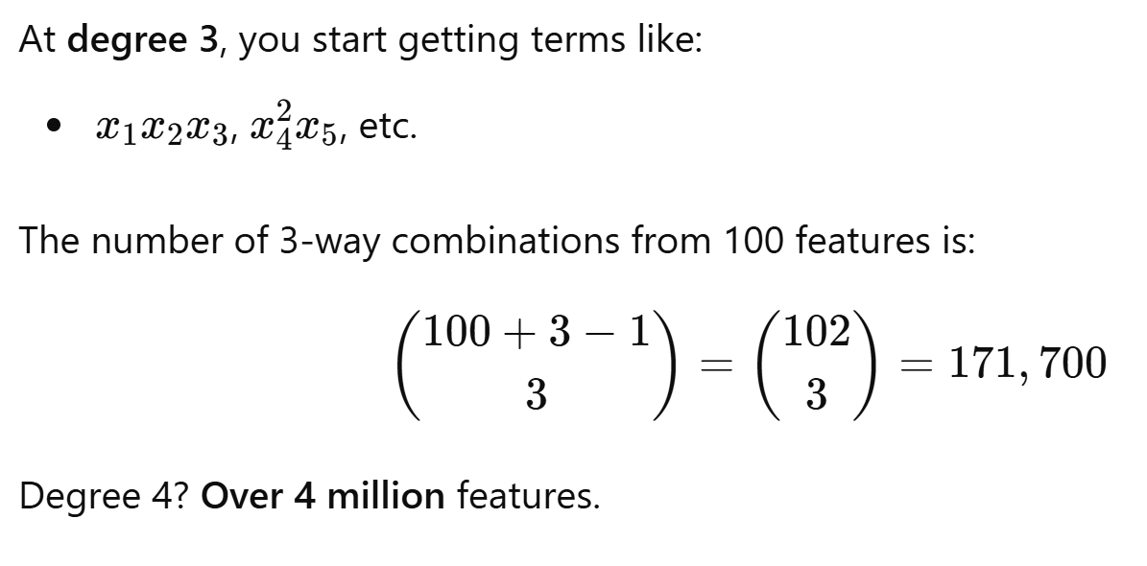

Support vector machine: kernels
Machine Learning Methods for Biomedical Data (D012554)

Slide 30
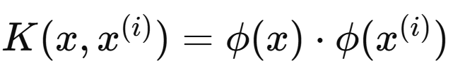



Support vector machine: kernels
Since the model only uses the dot product of the transformed feature vectors
we can replace that dot product by a kernel function
such that the model becomes
The data points for which are called the support vectors.
Machine Learning Methods for Biomedical Data (D012554)

Slide 31



Support vector machine: polynomial kernel
Machine Learning Methods for Biomedical Data (D012554)

Slide 32

Support vector machine: polynomial kernel
Machine Learning Methods for Biomedical Data (D012554)

Slide 33


Support vector machine: RBF kernel
Machine Learning Methods for Biomedical Data (D012554)

